Slide 1
Model selection
Francesco Bellotti, Università di Genova

Slide 2
Lecture outlook
Cross-validation: evaluating estimator performance
Tuning the hyper-parameters of an estimator
Metrics and scoring: quantifying the quality of predictions
Model persistence
Validation curves: plotting scores to evaluate models
https://scikit-learn.org/stable/model_selection.html

Slide 3
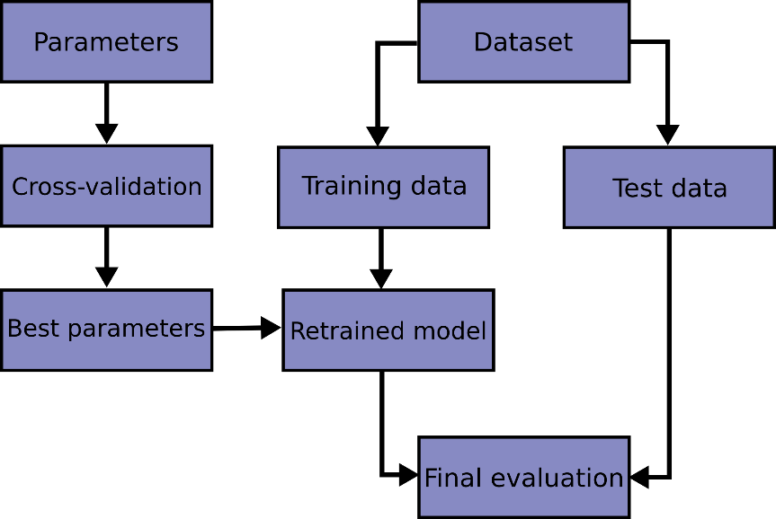
Training and testing
Learning the parameters of a prediction function and testing it on the same data is a methodological mistake: a model that would just repeat the labels of the samples that it has just seen would have a perfect score but would fail to predict anything useful on yet-unseen data.
This situation is called overfitting.
To avoid it, it is common practice when performing a (supervised) machine learning experiment to hold out part of the available data as a test set X_test, y_test.

Slide 4
Two sets, three sets?
When evaluating different settings (“hyperparameters”) for estimators, such as the C setting that must be manually set for an SVM, there is still a risk of overfitting on the test set because the parameters can be tweaked until the estimator performs optimally.
This way, knowledge about the test set can “leak” into the model and evaluation metrics no longer report on generalization performance.
To solve this problem, yet another part of the dataset can be held out as a so-called “validation set”:
training proceeds on the training set, after which evaluation is done on the validation set, and when the experiment seems to be successful, final evaluation can be done on the test set.
However, by partitioning the available data into three sets, we drastically reduce the number of samples which can be used for learning the model, and the results can depend on a particular random choice for the pair of (train, validation) sets.

Slide 5
K-fold cross validation
A solution to this problem is a procedure called cross-validation (CV for short). A test set should still be held out for final evaluation, but the validation set is no longer needed when doing CV.
In the basic approach, called k-fold CV, the training set is split into k smaller sets (other approaches are described below, but generally follow the same principles).
The following procedure is followed for each of the k “folds”:
A model is trained using k-1 of the folds as training data;
the resulting model is validated on the remaining part of the data (i.e., it is used as a test set to compute a performance measure such as accuracy).
The performance measure reported by k-fold cross-validation is then the average of the values computed in the loop.
This approach can be computationally expensive, but does not waste too much data (as is the case when fixing an arbitrary validation set)
Time/space trade-off

Slide 6

K-fold cross validation
Once the model is seleted: train on whole Train set

Slide 7
Computing cross-validated metrics
A general way to assess performance of an estimator under training
The simplest way to use cross-validation is to call the cross_val_score helper function on the estimator and the dataset.
scores = cross_val_score(clf, X_train, y_train, cv=5)
Default ‘scoring’ parameter: accuracy for classifiers, R^2 for regressors
Notes:
N.B., it has only one estimator. We’ll see later the parameter tuning (grid search)
For scoring: accuracy, precision, etc., see also scikit-learn.ppt

Slide 8
cross_validate
A more flexible/powerful function
The cross_validate function differs from cross_val_score in two ways:
It allows specifying multiple metrics for evaluation
It returns a dict containing fit-times, score-times (and optionally training scores as well as fitted estimators, one for each split) in addition to the test score
Notes:
As, before, we are dealing with only one estimator, not parameter tuning (grid search)

Slide 9
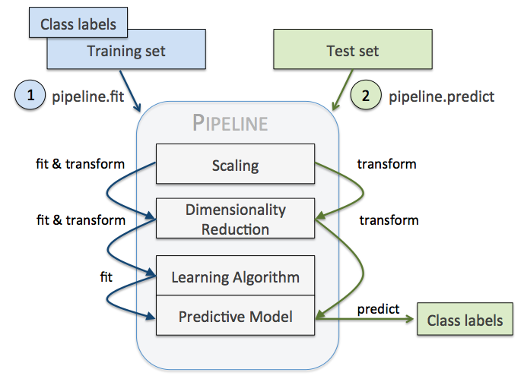
Recall
Just as it is important to test a predictor on data held-out from training, so, preprocessing (e.g., standardization, PCA, feature selection, etc.) and similar data transformations similarly should be learnt from a training set and applied to held-out data for prediction
Pipeline can streamline the coding process
A pipe is a composed estimator
https://iaml.it/blog/optimizing-sklearn-pipelines

Slide 10
Cross-validation iterators
Utilities to generate indices that can be used to generate dataset splits according to different cross validation strategies.
Cross-validation iterators for i.i.d. data
Assuming that some data is Independent and Identically Distributed (i.i.d.) is making the assumption that all samples stem from the same generative process and that the generative process is assumed to have no memory of past generated samples.
While i.i.d. data is a common assumption in machine learning theory, it rarely holds in practice. If one knows that the samples have been generated using a time-dependent process, it’s safer to use a time-series aware cross-validation scheme
Similarly if we know that the generative process has a group structure (samples from collected from different subjects, experiments, measurement devices) it safer to use group-wise cross-validation.

Slide 11
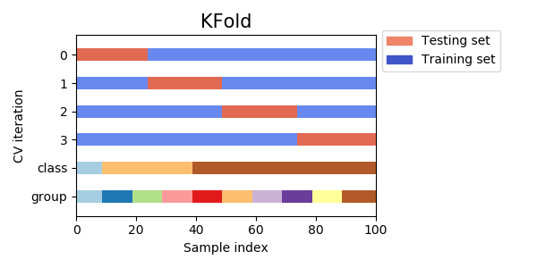
Cross-validation iterators for i.i.d. data

Slide 12
Leave one out
LeaveOneOut (or LOO) is a simple cross-validation. Each learning set is created by taking all the samples except one, the test set being the sample left out. Thus, for samples, we have different training sets and different tests set. This cross-validation procedure does not waste much data as only one sample is removed from the training set
Assuming k is not too large and k<n, LOO is more computationally expensive than k-fold cross validation.
As a general rule, most authors, and empirical evidence, suggest that 5- or 10- fold cross validation should be preferred to LOO.

Slide 13
Leave P out

Slide 14
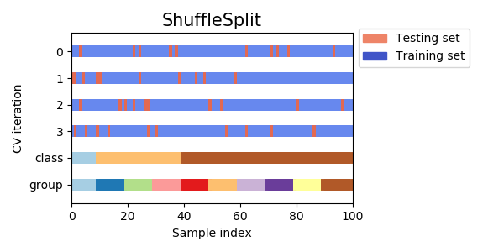
Random permutations cross-validation a.k.a. Shuffle & Split
The ShuffleSplit iterator will generate a user defined number of independent train / test dataset splits. Samples are first shuffled and then split into a pair of train and test sets.
It is possible to control the randomness for reproducibility of the results by explicitly seeding the random_state pseudo random number generator.
ShuffleSplit works iteratively (extraction at each step), KFold just divides the dataset into k folds
Notes:
https://stackoverflow.com/questions/34731421/whats-the-difference-between-kfold-and-shufflesplit-cv

Slide 15
Cross-validation iterators with stratification based on class labels.
Some classification problems can exhibit a large imbalance in the distribution of the target classes: for instance there could be several times more negative samples than positive samples.
In such cases it is recommended to use stratified sampling as implemented in StratifiedKFold and StratifiedShuffleSplit to ensure that relative class frequencies is approximately preserved in each train and validation fold.

Slide 16
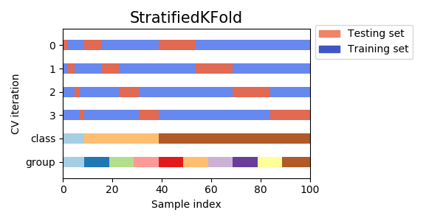
Stratified k-fold
StratifiedKFold is a variation of k-fold which returns stratified folds: each set contains approximately the same percentage of samples of each target class as the complete set.

Slide 17
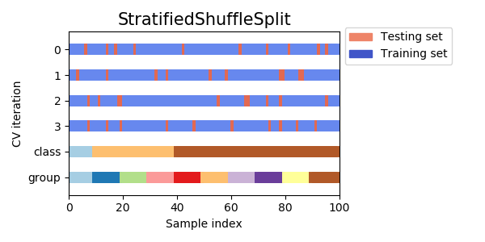
StratifiedShuffleSplit
StratifiedShuffleSplit is a variation of ShuffleSplit, which returns stratified splits, i.e which creates splits by preserving the same percentage for each target class as in the complete set.

Slide 18
Cross-validation iterators for grouped data.
The i.i.d. assumption is broken if the underlying generative process yield groups of dependent samples.
Such a grouping of data is domain specific.
An example would be when there is medical data collected from multiple patients, with multiple samples taken from each patient. And such data is likely to be dependent on the individual group.
In our example, the patient id for each sample will be its group identifier.
In this case we would like to know if a model trained on a particular set of groups generalizes well to the unseen groups.
To measure this, we need to ensure that all the samples in the validation fold come from groups that are not represented at all in the paired training fold.

Slide 19
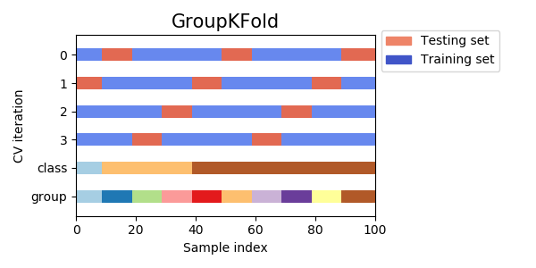
GroupKFold
GroupKFold is a variation of k-fold which ensures that the same group is not represented in both testing and training sets. For example if the data is obtained from different subjects with several samples per-subject and if the model is flexible enough to learn from highly person specific features it could fail to generalize to new subjects. GroupKFold makes it possible to detect this kind of overfitting situations.
Each subject is in a different testing fold, and the same subject is never in both testing and training.

Slide 20
Leave groups out
Leave one group out
Leave P groups out

Slide 21
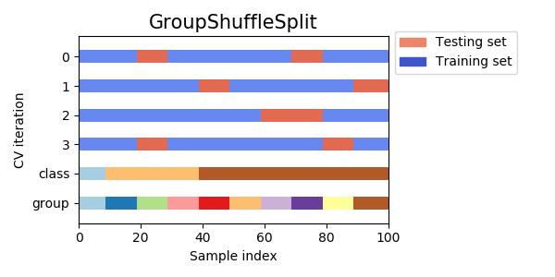
Group Shuffle Split
The GroupShuffleSplit iterator behaves as a combination of ShuffleSplit and LeavePGroupsOut, and generates a sequence of randomized partitions in which a subset of groups are held out for each split.
This class is useful when the behavior of LeavePGroupsOut is desired, but the number of groups is large enough that generating all possible partitions with groups withheld would be prohibitively expensive. In such a scenario, GroupShuffleSplit provides a random sample (with replacement) of the train / test splits generated by LeavePGroupsOut.
Notes:
Differently form GroupKFold, a group may appear in more validation sets (they are generated randomly at each iteration)

Slide 22
Cross validation of time series data
Time series data is characterised by the correlation between observations that are near in time (autocorrelation). However, classical cross-validation techniques such as KFold and ShuffleSplit assume the samples are independent and identically distributed, and would result in unreasonable correlation between training and testing instances (yielding poor estimates of generalisation error) on time series data.
Therefore, it is very important to evaluate our model for time series data on the “future” observations least like those that are used to train the model.

Slide 23
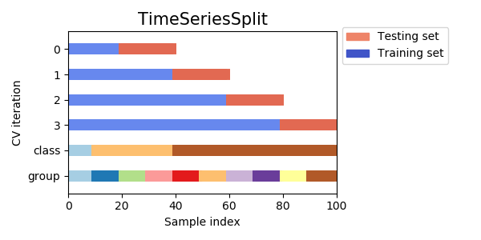
TimeSeriesSplit
TimeSeriesSplit is a variation of k-fold which returns first k folds as train set and the (k+1)th fold as test set (k=1...K-1). Note that unlike standard cross-validation methods, successive training sets are supersets of those that come before them. Also, it adds all surplus data to the first training partition, which is always used to train the model.
This class can be used to cross-validate time series data samples that are observed at fixed time intervals.

Slide 24
A note on shuffling
If the data ordering is not arbitrary (e.g. samples with the same class label are contiguous), shuffling it first may be essential to get a meaningful cross- validation result. However, the opposite may be true also if the samples are not independently and identically distributed.
For example, if samples correspond to news articles, and are ordered by their time of publication, then shuffling the data will likely lead to a model that is overfit and an inflated validation score: it will be tested on samples that are artificially similar (close in time) to training samples.
Some cross validation iterators, such as KFold, have an inbuilt option to shuffle the data indices before splitting them. Note that:
This consumes less memory than shuffling the data directly.
By default no shuffling occurs, including for the (stratified) K fold cross- validation performed by specifying cv=some_integer to cross_val_score, grid search, etc. Keep in mind that train_test_split still returns a random split.
The random_state parameter defaults to None, meaning that the shuffling will be different every time KFold(..., shuffle=True) is iterated. However, GridSearchCV will use the same shuffling for each set of parameters validated by a single call to its fit method.
To get identical results for each split, set random_state to an integer.
Notes:
First bullet:
Pay attention if there is a pattern in data. If there is a label (target) pattern, do the shuffle (if not already donw with train_test_split) If it is a time pattern, consider Time Series Cross Validation

Slide 25
Tuning the hyper-parameters of an estimator
Cross validation iterators can also be used to directly perform model selection using Grid Search for the optimal hyperparameters of the model.
Hyper-parameters are parameters that are not directly learnt within estimators.
In sk-learn they are passed as arguments to the constructor of the estimator classes.
Typical examples include C, kernel and gamma for Support Vector Classifier, alpha for Lasso, etc.
It is recommended to search the hyper-parameter space for the best cross validation score.
Any parameter provided when constructing an estimator may be optimized in this manner. Specifically, to find the names and current values for all parameters for a given estimator, use:
estimator.get_params()

Slide 26
Search for the best hyper-parameters
A search consists of:
an estimator (regressor or classifier such as sklearn.svm.SVC());
Could be also a composed estimator (pipeline)
a parameter space;
a method for searching or sampling candidates;
a cross-validation scheme; and
a score function
Some models allow for specialized, efficient parameter search strategies, outlined later.

Slide 27
Search
Two generic approaches to sampling search candidates are provided in scikit-learn:
for given values, GridSearchCV exhaustively considers all parameter combinations,
while RandomizedSearchCV can sample a given number of candidates from a parameter space with a specified distribution.
Note that it is common that a small subset of those parameters can have a large impact on the predictive or computation performance of the model while others can be left to their default values.
It is recommended to read the docstring of the estimator class to get a finer understanding of their expected behavior, possibly by checking the literature.

Slide 28
Exhaustive grid search
The grid search provided by GridSearchCV exhaustively generates candidates from a grid of parameter values specified with the param_grid parameter.
param_grid = [
{'C': [1, 10, 100, 1000], 'kernel': ['linear']},
{'C': [1, 10, 100, 1000], 'gamma': [0.001, 0.0001], 'kernel': ['rbf']},
]
The GridSearchCV instance implements the usual estimator API:
when “fitting” it on a dataset all the possible combinations of parameter values are evaluated and the best combination is retained.

Slide 29
Randomized Parameter Optimization
While using a grid of parameter settings is currently the most widely used method for parameter optimization, other search methods have more favourable properties.
RandomizedSearchCV implements a randomized search over parameters, where each setting is sampled from a distribution over possible parameter values.
Two main benefits over an exhaustive search:
A a computation budget can be chosen independent of the number of parameters and possible values.
n_iter param, being the number of sampled candidates or sampling iterations
Adding parameters that do not influence the performance does not decrease efficiency.
Automatic algorithm

Slide 30
Specifying parameters
Specifying how parameters should be sampled is done using a dictionary, very similar to specifying parameters for GridSearchCV.
For each parameter, either a distribution over possible values or a list of discrete choices (which will be sampled uniformly) can be specified:
{'C': scipy.stats.expon(scale=100), 'gamma': scipy.stats.expon(scale=.1),
'kernel': ['rbf'], 'class_weight':['balanced', None]}
Notes:
Probability density distribution

Slide 31
Continuous distribution of the params
For continuous parameters, such as C above, it is important to specify a continuous distribution to take full advantage of the randomization. This way, increasing n_iter will always lead to a finer search.
A continuous log-uniform random variable is available through loguniform. This is a continuous version of log-spaced parameters. For example to specify C above, loguniform(1, 100) can be used instead of [1, 10, 100] or np.logspace(0, 2, num=1000).
from sklearn.utils.fixes import loguniform
{'C': loguniform(1e0, 1e3),
'gamma': loguniform(1e-4, 1e-3),
'kernel': ['rbf'],
'class_weight':['balanced', None]}
Notes:
https://docs.scipy.org/doc/scipy/reference/generated/scipy.stats.loguniform.html
Num is the number of samples

Slide 32
Model selection: development and evaluation
Model selection by evaluating various parameter settings can be seen as a way to use the labeled data to “train” the parameters of the grid.
When evaluating the resulting model it is important to do it on held-out samples that were not seen during the grid search process: it is recommended to split the data into a development set (to be fed to the GridSearchCV instance) and an evaluation set to compute performance metrics.
This can be done by using the train_test_split utility function.
Once the model is selected: train on whole Train set (this is done automatically with SearchCV)

Slide 33
See example
ex1_param_estim_GridSearchCV.py
For the classification report see also scikit-le
ex2_randomSvsGridS.py

Slide 34
Tips for parameter search
Specifying an objective metric
Specifying multiple metrics for evaluation
Composite estimators and parameter spaces
Model selection: development and evaluation
Parallelism
Robustness to failure
Notes:
We’ll see in the following slides

Slide 35
Specifying an objective metric
By default, parameter search uses the score function of the estimator to evaluate a parameter setting
sklearn.metrics.accuracy_score for classification
sklearn.metrics.r2_score for regression.
For some applications, other scoring functions are better suited
For example in unbalanced classification, the accuracy score is often uninformative
An alternative scoring function can be specified via the scoring parameter to GridSearchCV, RandomizedSearchCV and many of the specialized cross-validation tools described later

Slide 36
R^2 (Coeff of determination)
R^2 (coefficient of determination) regression score function.
Is the proportion of the variance in the dependent variable that is predictable from the independent variable(s)
Best possible score is 1.0 and it can be negative (because the model can be arbitrarily worse).
https://en.wikipedia.org/wiki/Coefficient_of_determination
A constant model that always predicts the expected value of y, disregarding the input features, would get a R^2 score of 0.0.

Slide 37
Specifying multiple metrics for evaluation
GridSearchCV and RandomizedSearchCV allow specifying multiple metrics for the scoring parameter.
Multimetric scoring can either be specified as a list of strings of predefined scores names or a dict mapping the scorer name to the scorer function and/or the predefined scorer name(s).

Slide 38
Parallel execution
GridSearchCV and RandomizedSearchCV evaluate each parameter setting independently. Computations can be run in parallel if your OS supports it, by using the keyword n_jobs=-1.

Slide 39
Robustness to failure
Some parameter settings may result in a failure to fit one or more folds of the data.
By default, this will cause the entire search to fail, even if some parameter settings could be fully evaluated.
Setting error_score=0 (or =np.NaN) will make the procedure robust to such failure, issuing a warning and setting the score for that fold to 0 (or NaN), but completing the search.

Slide 40
Alternatives to brute force parameter search
Model specific cross-validation
Information Criterion
Out of Bag Estimates

Slide 41
Model specific cross-validation
Some models can fit data for a range of values of some parameter almost as efficiently as fitting the estimator for a single value of the parameter.
This feature can be leveraged to perform a more efficient cross-validation used for model selection of this parameter.
The most common parameter amenable to this strategy is the parameter encoding the strength of the regularizer (i.e., alpha). In this case we say that we compute the regularization path of the estimator.
LassoCV
LogisticRegressionCV
RidgeCV

Slide 42
Metrics and scoring: quantifying the quality of predictions
There are 3 different APIs for evaluating the quality of a model’s predictions:
Estimator score() method: Estimators have a score method providing a default evaluation criterion for the problem they are designed to solve.
Typically accuracy (for classifiers) and R^2 (for regressors). See each estimator’s documentation.
See example in 1_cross_validation.py
Scoring parameter: Model-evaluation tools using cross-validation (such as model_selection.cross_val_score and model_selection.GridSearchCV) rely on an internal scoring strategy.
Metric functions: The metrics module implements functions assessing prediction error for specific purposes.
Notes:
Code 2_scoring_metrics.py

Slide 43
The scoring parameter: defining model evaluation rules
Model selection and evaluation using tools, such as model_selection.GridSearchCV and model_selection.cross_val_score, take a scoring parameter that controls what metric they apply to the estimators evaluated.
For the most common use cases, you can designate a scorer object with the scoring parameter; the table below shows all possible values.
https://scikit-learn.org/stable/modules/model_evaluation.html#the-scoring-parameter-defining-model-evaluation-rules
All scorer objects follow the CV convention that higher return values are better than lower return values.
Thus metrics which measure the distance between the model and the data, like metrics.mean_squared_error, are available as neg_mean_squared_error which return the negated value of the metric.

Slide 44
Defining your scoring strategy from metric functions
The module sklearn.metrics also exposes a set of simple functions measuring a prediction error given ground truth and prediction:
functions ending with _score return a value to maximize, the higher the better.
functions ending with _error or _loss return a value to minimize, the lower the better.
When converting into a scorer object using make_scorer, set the greater_is_better parameter to False (True by default).
Many metrics are not given names to be used as scoring values, sometimes because they require additional parameters, such as fbeta_score. In such cases, you need to generate an appropriate scoring object.
The simplest way to generate a callable object for scoring is by using make_scorer. That function converts metrics into callables that can be used for model evaluation

Slide 45
Completely custom scorer objects
The second use case is to build a completely custom scorer object from a simple python function using make_scorer, which can take several parameters:
the python function you want to use (e.g., my_custom_loss_func)
whether the python function returns a score (greater_is_better=True, the default) or a loss (greater_is_better=False).
If a loss, the output of the python function is negated by the scorer object, conforming to the cross validation convention that scorers return higher values for better models.
for classification metrics only: whether the python function you provided requires continuous decision certainties (needs_threshold=True). The default value is False.
any additional parameters, such as beta or labels in f1_score.

Slide 46
Using multiple metric evaluation
For all the above, see: 2_scoring_metrics.py

Slide 47
Classification metrics
The sklearn.metrics module implements several loss, score, and utility functions to measure classification performance.

Slide 48
From binary to multiclass and multilabel
Some metrics are essentially defined for binary classification tasks (e.g. f1_score, roc_auc_score).
In these cases, by default only the positive label is evaluated, assuming by default that the positive class is labelled 1 (though this may be configurable through the pos_label parameter).
In extending a binary metric to multiclass or multilabel problems, the data is treated as a collection of binary problems, one for each class. There are then a number of ways to average binary metric calculations across the set of classes, each of which may be useful in some scenario.
Where available, you should select among these using the average parameter
See next page
Notes:
ROC curve, true positive vs false positive (false positive vs negative) rate – see next slides

Slide 49
From binary to multiclass and multilabel
"macro" simply calculates the mean of the binary metrics, giving equal weight to each class.
In problems where infrequent classes are nonetheless important, macro-averaging may be a means of highlighting their performance.
On the other hand, the assumption that all classes are equally important is often untrue, such that macro-averaging will over-emphasize the typically low performance on an infrequent class.
"weighted" accounts for class imbalance by computing the average of binary metrics in which each class’s score is weighted by its presence in the true data sample.
"micro" gives each sample-class pair an equal contribution to the overall metric (except as a result of sample-weight). Rather than summing the metric per class, this sums the dividends and divisors that make up the per-class metrics to calculate an overall quotient.
Micro-averaging may be preferred in multilabel settings, including multiclass classification where a majority class is to be ignored.
"samples" applies only to multilabel problems. It does not calculate a per-class measure, instead calculating the metric over the true and predicted classes for each sample in the evaluation data, and returning their (sample_weight-weighted) average.
Selecting average=None will return an array with the score for each class.
While multiclass data is provided to the metric, like binary targets, as an array of class labels, multilabel data is specified as an indicator matrix, in which cell [i, j] has value 1 if sample i has label j and value 0 otherwise.
Notes:
Multilabel like multiple tags

Slide 50
Accuracy score
Accuracy
The balanced_accuracy_score function computes the balanced accuracy, which avoids inflated performance estimates on imbalanced datasets.

Slide 51
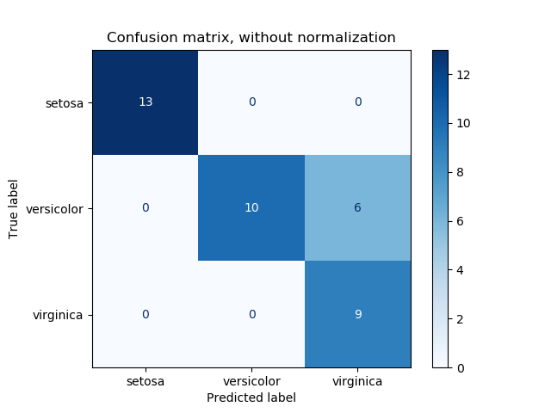
Confusion matrix
See example: ex4_confusion_matrix.py

Slide 52
Classification report

Slide 53
Binary classification

Slide 54
Multi-label confusion matrix

Slide 55
Receiver operating characteristic (ROC)
A receiver operating characteristic (ROC), or simply ROC curve, is a graphical plot which illustrates the performance of a binary classifier system.
It is created by plotting the fraction of true positives out of the positives (TPR = true positive rate) vs. the fraction of false positives out of the negatives (FPR = false positive rate), at various threshold settings.
TPR is also known as sensitivity, and FPR is one minus the specificity or true negative rate.”
https://stackabuse.com/understanding-roc-curves-with-python/
Notes:
Più vado a destra sul grafico e più decido positivo

Slide 56
Regression metrics

Slide 57
Explained variance
Check difference with R2 (coefficient of determination)
Difference is given by the mean error
Explained Variance Score = 1 - [Variance(Y_{predicted} - Y_{actual}) / Variance_{y_actual}]
https://en.wikipedia.org/wiki/Coefficient_of_determination (this also shows the meaning of the 0 value)
Notes:
https://stackoverflow.com/questions/24378176/python-sci-kit-learn-metrics-difference-between-r2-score-and-explained-varian

